Slide 1
Professional development Language of tables and graphs Session 1 (of 3)
Utrecht University

Slide 2
To start with ....... From the news today
What do you notice? What is the story with this graph/graphic?
Notes:
Prompt the participants to express themselves clearly. Use scaffolding techniques for this. For eaxmple:
- ask them clarify what they mean by words like 'it' , 'these/this' etc.
- ask them to distiungish between the language of the graph ('it goes up') and the language of the situation (the number of cases increases)
Note:
Replace this example with a recent local graph or table (that occured in the media).
The example should be mathematically interesting ('there should something to talk about') and not too difficult to interpret.

Slide 3
Program of the course 3 sessions
Session 1: The language of graphs and tables
some background
examples of tasks and student work in general and vocational contexts
Session 2: Focusing on line graphs
mathematical concepts
related language
Session 3: Rich communicatie practices involvog graphs and tables in vocational situations

Slide 4
Program session 1
Starter
About the relevance of language
About the teaching materials
Activity: worksheet and student work
Scaffolding
What does this mean for your teaching practice?
Reflection and looking forward

Slide 5
Program session 1
Starter
About the relevance of language
About the teaching materials
Activity: worksheet and student work
Scaffolding
What does this mean for your teaching practice?
Reflection and looking forward

Slide 6
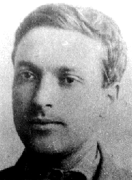
Two functions of language
Social function: communication and learning together
Individual function: thinking
Discussion, interaction and argumentation
are the basis for reasoning and reflection.
(Vygotskij, 1986)

Slide 7
Why do students need to learn language in the lessons?
They need language to understand:
Written language (methods, assessments)
Oral language (what the teacher and other pupils say)
They need language to talk and write
Talk: to participate in the math classroom
Write: to make notations (on the thinking).

Slide 8
Problems for students
(Maier & Schweiger 1999, Morek & Heller 2012 )
Language for communicating
Someone with less language proficiency, has difficulties expressing thoughts
Language for thinking/understanding
Someone with less language proficiency, has difficulties with understandig
Sprache
Denken
Denken
Denken
Sprache
Sprache
Problems
reading of tasks
presenting
writing
Problems
explaining (to self or others)
understanding connections (by thinking)
thinking by writing

Slide 9
The language of mathematics
Every schoolsubject has its own language.
The language of mathematics is different from the language of other schoolsubjects.
Mathematical language has specific features

Slide 10
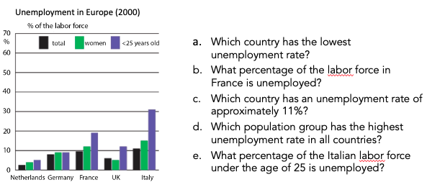
Multi-semiotic nature of mathematics
Language (text): What percentage of the Italian working population under 25 is unemployed?
Mathematical symbols: 11 %, 0,10, 20 etc.
Visual representations: bar graph

Slide 11
Overview features of mathematical language
Multi-semiotic nature: natural language, mathematical symbols, visual representations (graphs, charts, diagramms)
Specific academic vocabulary
Dense noun phrases
Expresses logical relations
Some words have another meaning in science than in other school subjects and in daily life (e.g function)
based on Schleppegrell, 2007

Slide 12
Types of language used in mathematics
General academic language (school language) increase, relation, gradually, pattern, process
Subject specific academic language (mathematical language) percentage, millimeter, proportion, axis, angle, cube, function
Everyday language passengers, ingredients, parquet

Slide 13
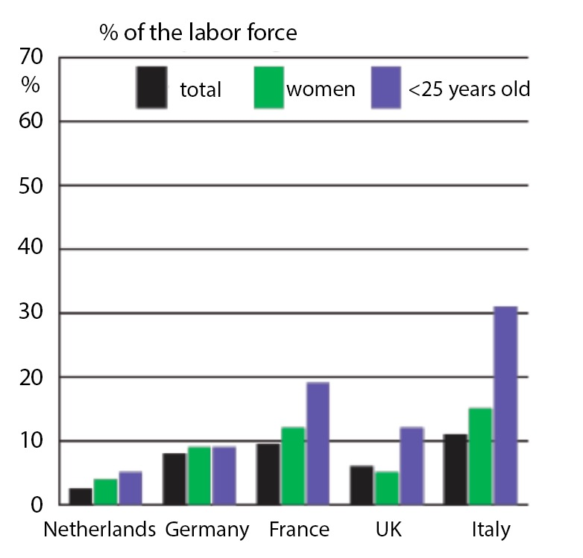
Analysis of a textbook task
Unemployment in Europe (2000)
a. Which country has the lowest unemployment rate?
b. What percentage of the labor force in France is unemployed?
c. Which country has an unemployment rate of approximately 11%?
d. Which population group has the highest unemployment rate in all countries?
e. What percentage of the Italian labor force under the age of 25 is unemployed?
In small groups analyse this task:
What types of language are used in the unemployment task?
Look at the problem through the eyes of the students: what might be difficult for them?

Slide 14
Discussion of the analysis
Types of language
Mathematical language -> .........
School language -> ...........
Everyday language -> ...........
Student difficulties
Notes:
Collect results of the analysis from the analysis

Slide 15
Academic language
Academic language is the language used in school to learn, speak and write about academic subjects.
It provides acces to specialised forms of reasoning that are needed to optimally participate in particular schoolsubjects
(Gibbons, 2009).
It is not only a question of learning new words but also of learning new styles of meaning and modes of argumentation.
Every school subject is constructed in language but the forms and patterns language takes vary from discipline to discipline.
(Schleppegrell, 2010)

Slide 16
What is relevant in language-responsive math classrooms?
Different registers (= languages and representations)
Symbolic-algebraic representation
Symbolic-numerical representation
Verbal technical register in first language
Verbal technical register in second language
Changing and
relating
registers and repre- sentations
Verbal school academic register in first language
Verbal school academic register in second language
Verbal everyday register in first language
Verbal everyday register in second language
Graphical representation
Concrete representation (artefact, actions etc.)
(Prediger & Wessel 2011, 2013; Prediger, Clarkson, & Bose 2015)

Slide 17
An example of students’ difficulties
Numbers of students at four schools
 | De Kameleon | Het Anker | De Oversteek | Sancta Maria
In 1996 | 338 | 182 | 220 | 203
In 1997 | 273 | 160 | 270 | 227
Question: At which school is the increase the biggest?
Many students answer: De Kameleon.
Can you explain this? Discuss in pairs.

Slide 18
An interview with Jouad on this task
T: Why do you add those numbers?
J: Because they ask at which school the increase is the biggest. You will figure out which number is the biggest
T: And you are sure this is what is asked?
J: Yes.
T: Do you understand all the words?
What does increase mean, for instance?
J: Eh, at which school… where is it biggest.
T: But how do you know this?
Jouad: Sometimes I just forget it.. at this question it is easy, because you already hear it ‘the biggest’. So then you know, then you do not have to use increase, because you know. Then you should figure out at which school it is the biggest. So, you can leave ‘increase’ out of it. And then you can just calculate it.
(Van den Boer, 2003)

Slide 19
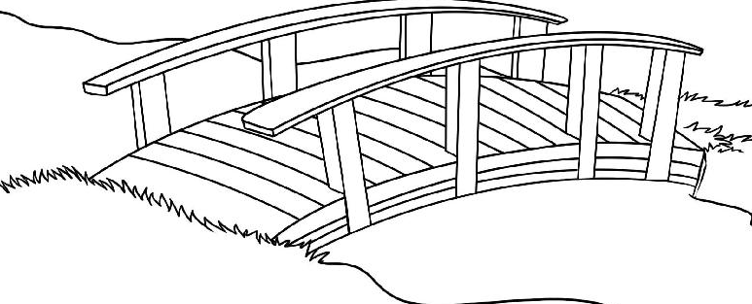
Bridging between BICS and CALP -> Teachers' task!
Academic language (CALP)
Cognitive Academic Language Proficiency
Daily language
BICS
Basic Interpersonal Communication Skills
Notes:
DAAR moet het gebeuren

Slide 20
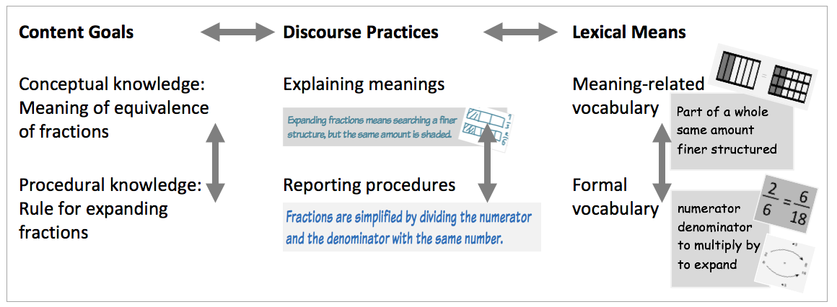
Jobs for teachers in language-responsive math classrooms
Five jobs
Noticing language
Demanding language
Supporting language
Developing language
Identifying mathematically relevant language demands
Pedagogical Tools
Formative assessment tools
Scaffolds in phrase list
Longer-term word bank
Discursively activating pedagogies and tasks
Scaffolds by cloze formats
Categories
General Orientations
Rich discourse practices instead of isolated words
Focus on conceptual understanding and explaining meaning
Offensive rather than defensive approach

Slide 21
Program session 1
Starter
About the relevance of language
About the teaching materials
Activity: worksheet and student work
Scaffolding
What does this mean for your teaching practice?
Reflection and looking forward

Slide 22
The language of tables and graphs
worksheets and teacher notes
Notes:
You can hand out the module to all participants if you want to and together flip through the contents and the instructions of mainly part 2.

Slide 23
Structure of the materials: 2 parts
Part 1: core communicative tasks
Three examples of rich communicative practices related to vocational situations involving tables or graphs
Communicative practices: giving advise, making decisions, consulting, explaining
Part 2: three lessons
'Traditionally structured' teaching unit for three lessons on the language of functions and graphs

Slide 24
Some design principles
Contexts
'familiar' enough to talk about
connected to vocational situations (especially communicative tasks)
connected to meaningful math
Interaction
between students – cooperative learning
between teacher and students -> scaffolding language (and understanding)
role-playing in vocational communicative tasks
Supporting language and improving mathematical understanding
text frames
exemplary (lists of) words and expressions
supporting mathematical reasoning (by e.g scaffolding)

Slide 25
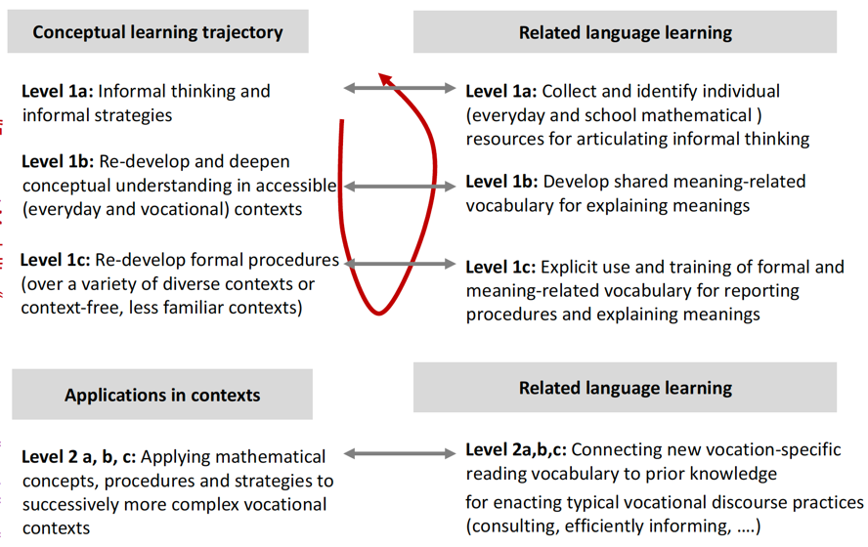
Conceptual and language learning

Slide 26
Part 1: Three communicative core tasks
General structure of the tasks
Exploring the context and its language
Eploring the mathematical concepts and the mathematical language
Preparing the communication (e.g. writing a script)
Communicative practice (role-play, podcast, blog/vlog, .....)
Reflecting
Note: these tasks will be the focus of PD session 3
Notes:
Deze terugvertaald uit het nederlands, even vergelijken met de volgende sheet.

Slide 27
Part 2: Four ‘phases’
 | Learning strand Graphs/diagrams/tables | Learning strand Language
1 | Activate and re-use previous knowledge about tables and graphs, by using examples of everyday and vocational contexts | Emphasis on oral interaction, by using different kinds of language: everyday language, vocational language and academic (school and mathematical) language. Students mainly talk together and write a little.
2 | Combining different representations: graphs/diagrams, tables and text especially for line-graphs. Know, name and use mathematical characteristics of each representation. | (Re-)introduce the (mathematical) language of (line)graphs/diagrams/tables. Make an explicit connection between the mathematical concepts, the mathematical language and the 'situational' language of the vocational or everyday contexts.
3 | Practice the use of different representations and their connections. Broaden the number and type of representations. If needed include a stronger relation with functions. | Apply the language of mathematics for different representations (fitting situations from home, school and work) and connect this to the (complex) language of vocational situations and everyday situations
Take a look at page 9 of the unit for an overview of the types of activities

Slide 28
Dutch students working on the unit

Slide 29
Program session 1
Starter
About the relevance of language
About the teaching materials
Activity: worksheet and student work
Scaffolding
What does this mean for your teaching practice?
Reflection and looking forward

Slide 30
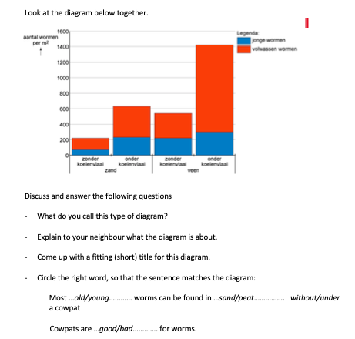
Exemplary worksheet from the unit - phase 1 (see handout)
- With a partner do the tasks on this worksheet
- Reflect on the language needed
Sharing findings in the whole group
- What types of language use?
- Expected difficulties for students

Slide 31
Student work on worksheet 9
Students' answers on the question: what is this diagram about?
Individually: order the students' answers from best to worst in the table at the bottom of the worksheet.
In pairs: share your orderings and your reasons behind it and together make a list of language related difficulties the student work shows.
Whole group: collect student difficulties in a list. Come up with means to support the students in overcoming these difficulties
Notes:
Language difficulties:
Understanding the graph (combining information)
Writing coherent whole sentences
Giving proper words to the information the graph entails
Being specific
Support
Give students a writing frame, for example the start of sentences they can complete
Give them a lits of words and phrases that can be used to combine sentences
In whole class discuss the context of the diagram have students make statements about specific information in the graph, scaffold student utterances.

Slide 32
Program session 1
Starter
About the relevance of language
About the teaching materials
Activity: worksheet and student work
Scaffolding
What does this mean for your teaching practice?
Reflection and looking forward

Slide 33
Scaffolding language
Adaptive linguistic support that helps students in developing the language abilities that enables students to think and communicate independently in school subjects.
(see Gibbons, 2002, 2009)

Slide 34
What is scaffolding?
Scaffolding refers to a variety of instructional techniques like asking questions, reformulating, structuring in steps.
Scaffolding is not just any help or support. It is temporary and responsive support to help students to reach higher levels of comprehension or development of skills than they would not be able to achieve without assistance.
Scaffolding ultimately aims at students’ independence in the learning process.
(Wood, Bruner & Ross,1976).

Slide 35
Repertoire of scaffolding strategies
Reformulating or extending pupils’ spoken or written utterances
Referring to or reminding of linguistic features
Referring to or reminding of structure features
Asking pupils to improve language
Repeating correct pupils’ utterances or making explicit the good quality of pupils’ utterances
Asking for or encouraging pupils’ explicitly to independently produce spoken or written language

Slide 36
Program session 1
Starter
About the relevance of language
About the teaching materials
Activity: worksheet and student work
Scaffolding
What does this mean for your teaching practice?
Reflection and looking forward

Slide 37
Answer the questions in the poll
(Prediger 2016 | Sprachliche Lernziele)
In your teaching practice to what extent do your students face language related problems? Give one or more examples.
In your teaching practice do you pay specific attention to 'the language of mathematics'? Give one or more examples of how you do this.
What means do you use to support students language development in your teaching? Give one or more examples
Notes:
Make this poll in a digital tool with open answers (free wirting space)
After all praticipants have entered their answers you may either display and discuss them in this sessions or in the next one, Use the input for adjusting the sessions to the teachers background

Slide 38
Prepare a language-sensitive activity on graphs/diagrams
in small groups discuss these steps and think of an example to use in class
Select an approriate graph/diagram
What is the mathematical content and goal for the activity with this graph/table/diagram? What task(s) do you give students?
What are the linguistic demands in this activity and what goal(s) do you set related to the use of (mathematical) language?
How do you plan to activate your students in producing language in this activity?
What language support do you provide?

Slide 39
Program session 1
Starter
About the relevance of language
About the teaching materials
Activity: worksheet and student work
Scaffolding
What does this mean for your teaching practice?
Reflection and looking forward

Slide 40
Reflecting on the session
What was an eye opener for you?
What do you take home (to school)?
Write a tip and a top.

Slide 41
For the next session
1. Prepare and design a language-senstitive teaching activity with a diagram/graph
Use the lessonplan (in the handout)
Include all student materials
2. Try this activity with your students (whole claas or small group)
Write a brief report: what went well? What problems arose? What improvements would you make to overcome these? Include some examples of the work of your students.
Bring all materials with tou to session 2.
In this session we will share materials and findigs and we will focus on the topic of line graphs.
Notes:
Arbeitsauftrag gibt es auch im Arbeitsmaterial: DZLM-Sprache-BS2-AM-Arbeitsauftrag-Distanzphase.docx

Slide 42
Orientierung für nächste Folien

