Slide 1
Professional development Language of tables and graphs Session 2 (of 3)
Utrecht University

Slide 2
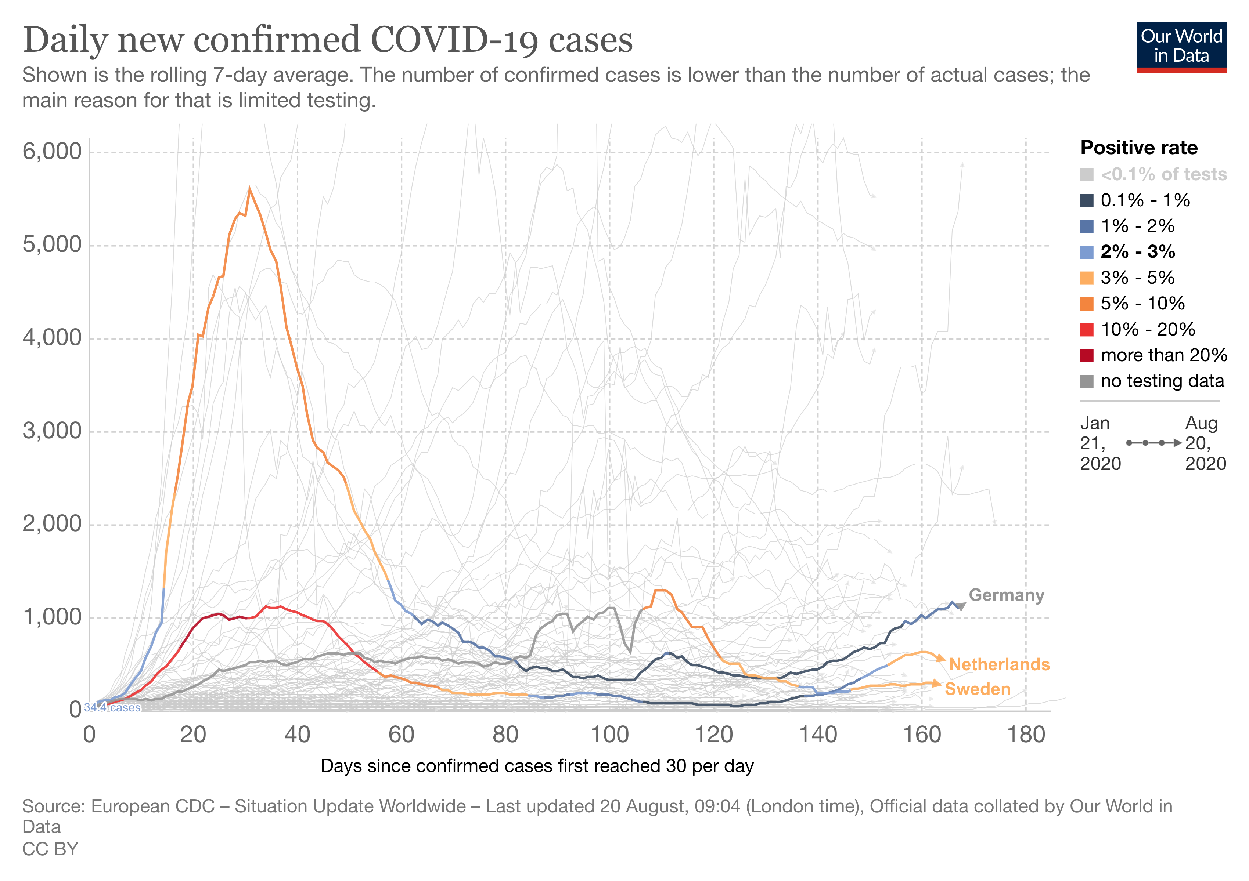
To start with ....... From the news today
What do you notice? What is the story with this graph/graphic?
Notes:
Note:
Replace this example with a recent local linegraph (that occured in the media).
The example should be mathematically interesting ('there should something to talk about') and not too difficult to interpret.
Prompt the participants to express themselves clearly. Use scaffolding techniques for this. For eaxmple:
- ask them clarify what they mean by words like 'it' , 'these/this' etc.
- ask them to distiungish between the language of the graph ('it goes up') and the language of the situation (the number of cases increases)
Source: https://ourworldindata.org/coronavirus

Slide 3
Program of the course 3 sessions
Session 1: The language of graphs and tables
some background
examples of tasks and student work in general and vocational contexts
Session 2: Focusing on line graphs
mathematical concepts
related language
Session 3: Rich communicatie practices involving graphs and tables in vocational situations

Slide 4
Program session 2
Starter
Sharing outcomes homework
Background on language of line-graphs
Activity: reflecting on student work
Research into the language of line graphs
What does this mean for your teaching practice?
Reflection and looking forward

Slide 5
Homework you did
1. Prepare and design a language-sensitive teaching activity with a diagram/graph
Use the plan and evaluation form in the handout
Include all student materials
2. Try this activity with your students (whole class or small group)
Write a brief report (you can us the form): what went well? What problems arose? What improvements would you make to overcome these? Include some examples of the work of your students.
Bring all materials to session 2.
Notes:
Arbeitsauftrag gibt es auch im Arbeitsmaterial: DZLM-Sprache-BS2-AM-Arbeitsauftrag-Distanzphase.docx

Slide 6
Prepare a language-sensitive activity on graphs/diagrams
Select an approriate graph/diagram
What is the mathematical content and goal for the activity with this graph/table/diagram? What task(s) do you give students?
What are the linguistic demands in this activity and what goal(s) do you set related to the use of (mathematical) language?
How do you plan to activate your students in producing language in this activity?
What language support do you provide?

Slide 7
Sharing materials and experience
In groups of 3 share your findings (15 min)
use the forms you filled in!
Focus on the aspect of (mathematical) language
At the end note for each participant (5 min):
one top – this went very well
one tip – this can be improved
Share these outcomes with the whole group (10 min)
focus on 'lessons learned'

Slide 8
Program session 2
Starter
Sharing outcomes homework
Background on language of line-graphs
Activity: reflecting on student work
Research into the language of line graphs
What does this mean for your teaching practice?
Reflection and looking forward

Slide 9
What may go wrong in students' answers?
Notes:
You can have participants do this activity themselves first and them think of student mistakes.
Collect 'mistakes:
Examples of mistakes:
- interpreting the graph as a picture of the situation -> walking up and down a hill
- interpreting the vertical axis as representing speed (so horizontal part means 'standing still')
- difficulty in combining both variables: 'they walked for 5 hours' (neglecting distance); 'they walked 5 km' (neglecting time, and misinterpreting distance)
Source: The language of functions and graphs, Shell Center
https://www.stem.org.uk/elibrary/resource/25495#:~:text=The%20Language%20of%20Functions%20and%20Graphs%20focuses%20on%20developing%20fluency,and%20with%20the%20whole%20class.

Slide 10
Difficulties line graphs
Mathematical understanding of 'relations', patterns; etc.
'Graph as picture'
'Academic (mathematical) language of representations
Which of these (or related) problems do you recognize in your own teaching?

Slide 11
Language of line graphs
Together make an overview of words and expressions related to line graphs representing a situation.
line graphs
Notes:
On a central board collect all words and expressions into a mindmap.
You can also have participants write on sticky notes and collect these or use a digital tool that produces a mindmap or wordcloud.

Slide 12
Two ways of looking at graphs
Each with its own language
'technical' math language, short, precise, numbers, "a table will do"
In detail
reading information 'point by point'
As a whole
seeing the process of change
detecting a pattern
noticing 'movement'
varied language, also terms related to the situation

Slide 13
Language of Graphs
Organising your wordweb
Distuingish mathematical and other language
For each mathematical expression describing a line graph, give a situational example of its meaning
The graph ascends -> the baby is getting taller
Notes:
Go back to sheet 11 and distuingish the type of language by using different colors

Slide 14
Examplary didactical sequence for language if linegraphs
Matching graphs and stories (descriptions)
Reflecting on the distinction between mathematical language of graphs and situational language.
Drawing a graph for a story
Translating from text of situation to representation in a graph
Telling an d writing a story for a graph
Translating from mathematical respresentation to context
Connecting the langauge of the story to the language of the graph
Notes:
Yoy may yous the teaching unit alongside and have teachers leaf through it to identify these activties

Slide 15
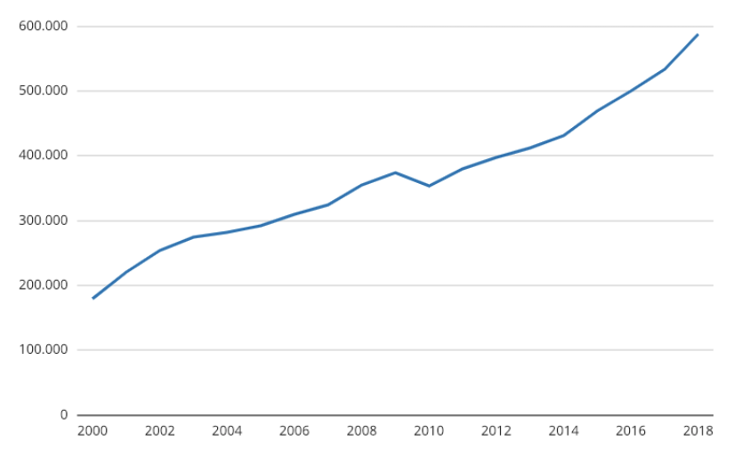
Exemplary worksheet 1 – telling a story for a graph
Number of goats in the Netherlands (2000-2018)
Discuss and answer the following questions
- What is the graph about?
- What do you notice?
Tell the story that goes with the graph.
Record your story with your mobile phone.
Listen to the stories in pairs and discuss them together.
- Which are the most important words in your story?
- Write them down below.

Slide 16
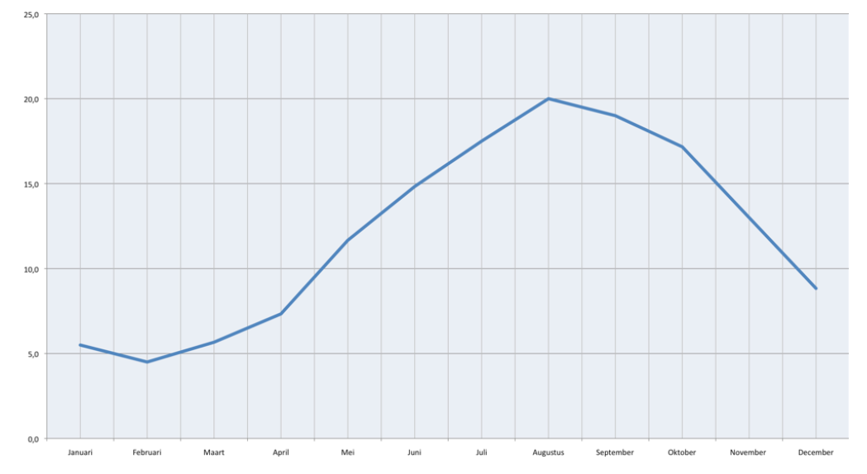
Examplary worksheet 2
Temperature of water in the North sea during 1 year
What tasks/questions would you give your students?
Notes:
Now describe what the graph looks like. Use words like the ones below.
Fall, rise, slow, decrease, increase, quick, constant, fluctuate, steep, gradual, highest point (top), lowest point, dip, sudden change, horizontal, gradually
D
Complete the sentences below:
The sea water is gradually heating up in the months …….…. , ……………. and …………… I can see that from the graph that ………………….. ………………………
From the month …………………… on, the sea water quickly cools. I can see that from the graph that ……………………………………………………… then. The cooling continues until the month ………………. . I can see that from the graph that ……………………………………………………… then.
E
Together with the class make a word web with the mathematical words that go with line graphs.

Slide 17
Program session 2
Starter
Sharing outcomes homework
Background on language of line-graphs
Activity: reflecting on student work
Research into the language of line graphs
What does this mean for your teaching practice?
Reflection and looking forward

Slide 18
Analysing student work
In groups of three analyse the student work on worksheets 1 & 2
Use the following questions to guide your analysis:
What does each student appear to understand? How do you know?
List errors and difficulties that are revealed by the students' work.
Try to identify the thinking of each student?
What feedback would you give each student?
Discuss in what ways you would support your students in the learning of (the language of) line graphs? Be as specific as possible.

Slide 19
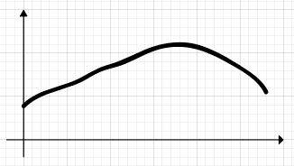
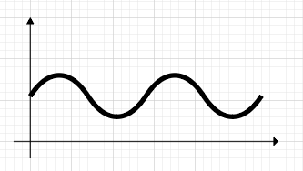
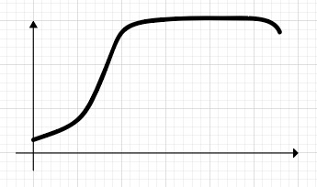
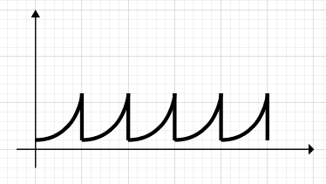
2 – Matching graph & title
A
C
Length of a man during his life
Temperature during a day
Height of weed over several years
Sea level during a day
Height of water in plastic bottle with a hole in the bottom
Your bicycle route from home to school
B
D
Notes:
Leerlingwerk van 35, 45 en 50

Slide 20
A
Temperature during a day
Begins cold and in the afternoon warm, and then cooling down quietly

Slide 21
B
Length of a man during his life
Grows very fast and only late he shrinks

Slide 22
C
Sea level during a day
Sometimes quiet and sometimes waves

Slide 23
Height of wheat over several years
Becomes big and then they trim it again

Slide 24
Drawing a graph for a story
Nick gets on his bike and starts a ride from his home.
Then he rides along the street with constant speed before it carves up a hill.
On top of the hill, he pauses for a few minutes to enjoy the view.
After that he drives back down and stops at the bottom of the hill.
Draw a graph to show how his speed changes as a function of the time.
speed
time

Slide 25
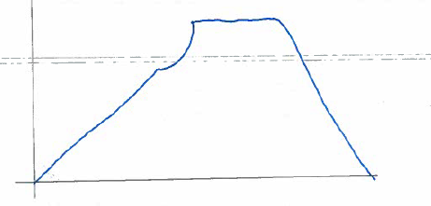
student 1

Slide 26
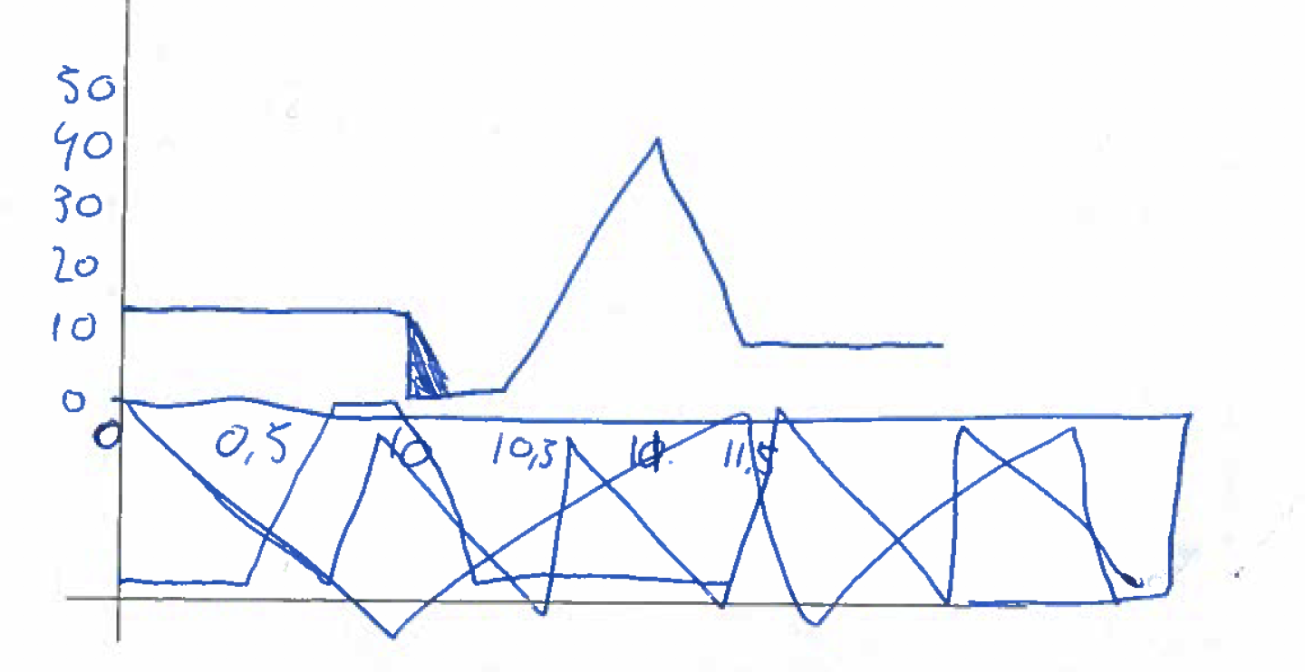
student 2

Slide 27
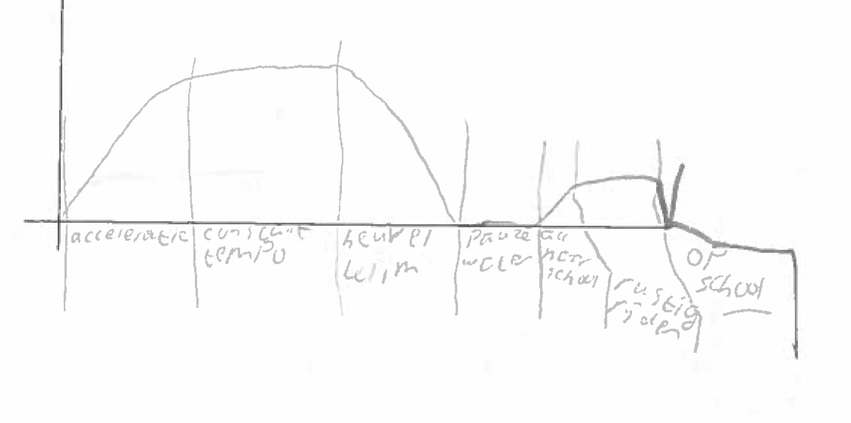
Student 3
accelerates
constant
speed
hill climb
break
accelerates
at school
driving
quiet

Slide 28
Reflecting on student work
In the whole group discuss the findings of the analysis in small groups. Use the guiding questions.
What does each student appear to understand? How do you know?
List errors and difficulties that are revealed by the students' work.
Try to identify the thinking of each student?
What feedback would you give each student?
In what spcific ways would you support your students in the learning of the lanaguage of line graphs?

Slide 29
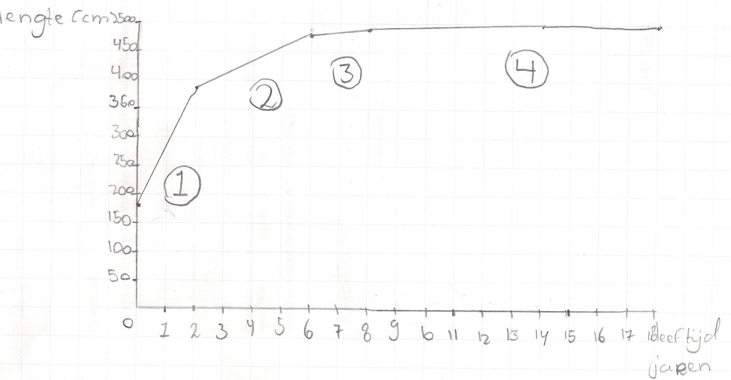
A line graph on the growth of Niek the Giraffe:
Notes:
to help students describing a graph you can give a writing frame

Slide 30
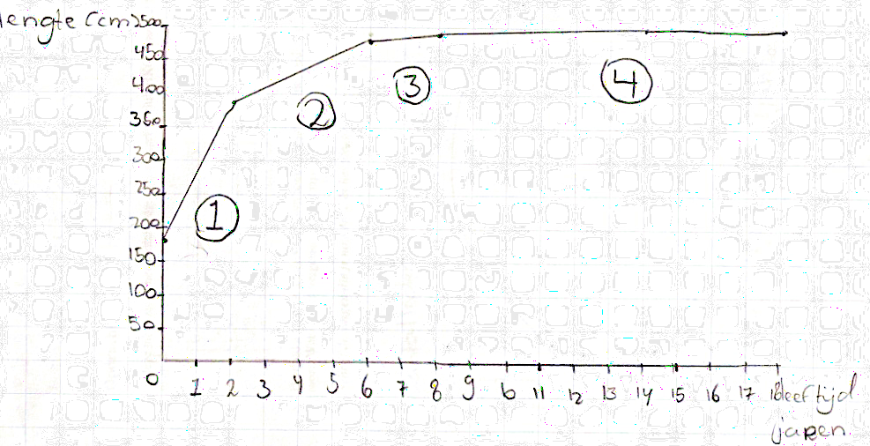
Example of support by a Speaking and writing frame
When Niek is born, he is …………………………
The first years …………………………………………
You can see that in the graph that………………………….
From his 2nd birthday on …………………………………
The graph………………………………………………………
After he has become 6 ………………………………………………….
You can see that …………………………………………………
When he is about 9 years old………………………
The graph ………………………………………………………
Finally Niek………………………………….
Notes:
Not that in this writing frame both langauge systems (of the situation) and of the graph are distinct but connected.

Slide 31
Different language systems in the dpeaking and writing frame
When Niek is born, he is …………………………
The first years …………………………………………
You can see that in the graph that………………………….
From his 2nd birthday on …………………………………
The graph………………………………………………………
After he has become 6 ………………………………………………….
You can see that …………………………………………………
When he is about 9 years old………………………
The graph ………………………………………………………
Finally Niek………………………………….
Notes:
Note that in this writing frame both langauge systems (of the situation) and of the graph are distinct but connected.

Slide 32
Program session 2
Starter
Sharing outcomes homework
Background on language of line-graphs
Activity: reflecting on student work
Research into the language of line graphs
What does this mean for your teaching practice?
Reflection and looking forward
Notes:
The following is based on the research of Jantien Smit: scaffolding language in multilingual classrooms
see: https://www.internationalhu.com/research/researchers/jantien-smit

Slide 33
Interpretative description of the line graph
Number of travellers at the railway staion
At 6 o'clock about 100 travellers are at the station. Between 6 and 8 o'clock the number of travellers increases much. The graph shows a steep ascend. [...]

Slide 34
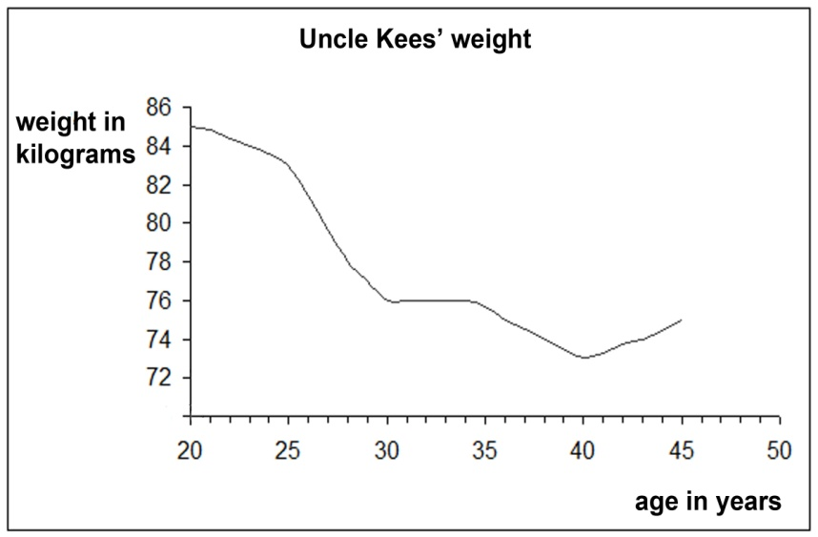
Genre: Interpretative description of a line graph
Write an interpretative description for this graph.

Slide 35
STRUCTURE FEATURES
s1. Describes each segment in terms of what happens in reality Between his 25th and his 30th birthday his weight quickly diminishes
s2. Describes each segment in terms of the graph’s course The graph descends gradually.
s.3 Describes peaks and troughs when present in the graph. When uncle Kees is 40 his weight reaches its minimum: about 74 kilograms.
Notes:
distuingishes the language of the context (reality) and the mathematical language of the graphs
This frame and the one on the next slide can be used to analyse descriptions of graphs

Slide 36
LINGUISTIC FEATURES
L1. Includes general academic language in the description of reality ...his weight decreases quickly … his weight remains constant
L2. Uses words such as ‘as’, ‘at’, ‘in’ and ‘when’ to refer to moments in time (i.e. points in the graphs). At the age of 40 ...
L3. Uses word combinations such as ‘from…to’, ‘between…and’ and ‘from…onwards’ to refer to periods in time (i.e. segments of the graph). Between his 25th and 30th ….

Slide 37
Interpretative description
At the age of 20 Uncle Kees weighs 85 kilograms. Between his 20th and his 25th birthday, he slowly loses weight. The graph descends gradually.
Between his 25th and his 30th birthday his weight decreases quickly. You can tell as the graph shows a steep fall. From his 30th to his 35th birthday his weight remains more or less the same. The graph is constant.
Between his 35th and his 40th birthday he slowly loses weight; the graph gradually descends.
When Uncle Kees is 40 his weight reaches its minimum: about 74 kilograms. From the age of 40 on his weight increases slightly. In this part, the graph gradually rises.

Slide 38
Teaching and learning cycle
building the field: exploring the domain of line graphs, introduction of general academic and subject-specific language (word list)
modeling the genre: dividing the graph in segments, using speaking and writing frames, discussing model texts, discussing pupil utterances in a subsequent lesson
joint construction: writing a text in the curriculum genre together: teacher-class (out loud)
independent writing: pupils write in the curriculum genre independently

Slide 39
Videofragment scaffolding language

Slide 40
Scaffolding language: an example
Teacher: How can he tell his age? Where does he see that? Youness.
Youness: Down below.
Teacher: Can you speak up? We cannot hear that.
Youness: Down below, at (…?).
Teacher: And down below, for that we know proper mathematical language. Oussana?
Oussana: Horizontal axis.
Teacher: Why don’t you put that in a sentence. It’s just a word on its own like this.
Oussana: Along the horizontal axis it says age in years.
Teacher: That’s a beautiful sentence, isn’t it? OK.
Notes:
link to video (not open):How does the teacher scaffold language? Try to identify and name some strategies the teacher uses in this sg=heet and the next.

Slide 41
Yassin when he was 30 and 35, he just stays 76 kilogram (points to the numbers)
Teacher Wait a second. How do we make this into a beautiful sentence? When he was 30 and 35. How should we do this, Oussana?
Ousana 30 til 35 he stayed the same.
Teacher Is is 30 till 35?
Amir From.
[........]
Yassin Uncle stays, uncle stays constant, uncle Kees stays constant.
Teacher Yes, do I stay constant in the same position? What stays constant? I am uncle Kees (teacher acts out 'staying in a fixed position).
Younes The kilograms.
Teacher And how do we say this? Not 'my kilograms
Yassin The weight of uncle Kees stays at 76 kilograms.
Teacher Yes. the weight remains teh same. And you see this in the graph?
Yassin which stays constant.
Teacher Yes, now you did use beuatiful math language

Slide 42
Results: proficiency in the pedagogical genre on pre-and posttest
 | Pretest | Posstest | Difference
Mean of the class | 3,73 | 6,63 | +2,90
Progress in het genre is statistically significant (t = 8,38; df = 21; p < 0,001), effect size d = 1,79.

Slide 43
Hoe did the teacher learn to scaffold?
Discussions between lessons
Teacher as co-designer
Stimulated recall interviews
Reflective reports of the teacher
(see Smit & Van Eerde, 2011)

Slide 44
Creating conditions for scaffolsing language
Pay attention to the interaction norms in class
Give students enough time to think individually when posig a question
Encourage students to produce language (in speaking and writing)
Listen for and react on the quality of verbal utterances

Slide 45
How did the teacher reflect on the lessons?
“Language is now always an issue.”
“The best scaffolds are...like that writing plan. That we give them something which makes them think: ‘I know a first sentence’. Scaffolds like these are so important!”
“For a teacher it is like learning a new profession. And I notice that I still have to practice. And that’s why...a professional development course wouldn’t be bad because these strategies are not easy to master.”

Slide 46
How do the students look back?
“ That we have learned new words for math and language.”
“ I now know how graphs come into being.”
“ Writing about a graph. It is an easy and good way.”

Slide 47
Language development of students
Students:
produce more language
describe a graph in more detail (they often distuingish more parts)
use more mathematical terms and use these in a more and more approriate way
speak and write using proper grammar
show more and more mathematical understanding; e.g thet distuiguish moments (points in a grpag) in time from periods or tim intervals (segments in a graph)

Slide 48
Program session 2
Starter
Sharing outcomes homework
Background on language of line-graphs
Activity: reflecting on student work
Research into the language of line graphs
What does this mean for your teaching practice?
Reflection and looking forward
Notes:
The following is based on the research of Jantien Smit: scaffolding language in multilingual classrooms
see: https://www.internationalhu.com/research/researchers/jantien-smit

Slide 49
Steps for designing language-sensitive math teaching
Scaffolding strategies
Rephrase student utterance (oral or written).
Remind students of the necessary thinking steps and the wording
Ask students to improve wrong wordings (what is another way for saying this?)
repeat correct examples or encourage students to phrase their thinking steps themselves.
Gradually decrease the support when it is less needed.
Decide on the mathematical aims for the task
Analyse what 'thinking steps' students have to take
Analyse what language they need
Support this language by scaffolding it
Notes:
Ask teachers to use this in practice

Slide 50
Program session 2
Starter
Sharing outcomes homework
Background on language of line-graphs
Activity: reflecting on student work
Research into the language of line graphs
What does this mean for your teaching practice?
Reflection and looking forward
Notes:
The following is based on the research of Jantien Smit: scaffolding language in multilingual classrooms
see: https://www.internationalhu.com/research/researchers/jantien-smit

Slide 51
Reflection
What was most valuable for you in this session?
What will you use in your teaching practice?
Give one tip and one top for this session

Slide 52
For the next session
1. Explore part 1 of the module. Select one of the communicative activities from this part and try this with your students (whole class or small group)
Write a brief report: what went well? What problems arose? What improvements would you make to overcome these? Include some examples (audio, video or written) of the work of your students.
2. Look for examples of communication in vocational settings involving graphs, diagrams or tables. Talk to your vocational colleagues or ask your students about their vocational practice.
3. Optional:
Design a language sensitive line-graph activity fitting your class and try it out. Pay particular attention to the way you want to scaffold discussions
Bring all materials to session 3.

