Slide 1

Professional development
Language of tables and graphs
Session 3 (of 3)
Utrecht University

Slide 2
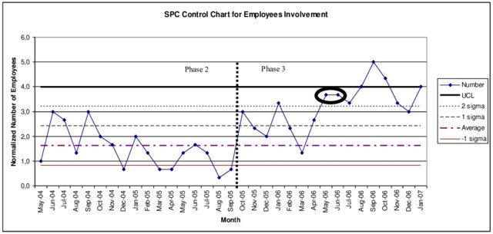
To start with .......
Notes:
Note: You may replace this example with a local example from vocational education
Discuss this graph It is a Statistical Process Control (SPC) chart, it is used for monitoring and controlling qualiity for example in industry.
Fig. 2. SPC Control Chart of the normalized number of employees initiating process improvements. Control Lines are calculated based on first 15 points. First ellipsis marks the first alert triggered by a Shewhart's Test. Self work based on the organization's data.
See also: https://en.wikipedia.org/wiki/Control_chart
If the process is in control (and the process statistic is normal), 99.7300% of all the points will fall between the control limits. Any observations outside the limits, or systematic patterns within, suggest the introduction of a new (and likely unanticipated) source of variation, known as a special-cause variation. Since increased variation means increased quality costs, a control chart "signaling" the presence of a special-cause requires immediate investigation.
source: https://www.researchgate.net/publication/333405858_Increase_in_Attention_to_Quality_Process_Improvement_by_Involvement_of_Engineers_Participating_in_Projects/figures?lo=1
:

Slide 3
Program
Starter
Role of communication in vocational situations (+graphs)
Examples from the module: rich communicative practices
Sharing outcomes of classroom experiment (homework)
Analysing student work and reflection
Evaluation

Slide 4
Homework
1. Explore part 1 of the module. Select one of the communicative activities from this part and try this with your students (whole class or small group)
Write a brief report: what went well? What problems arose? What improvements would you make to overcome these? Include some examples (audio, video or written) of the work of your students.
2. Look for examples of communication in vocational settings involving graphs, diagrams or tables.
Talk to your vocational colleagues or ask your students about their vocational practice.
3. Optional:
Design a language sensitive line-graph activity fitting your class and try it out. Pay particular attention to the way you want to scaffold discussions
Bring all materials to session 3.

Slide 5

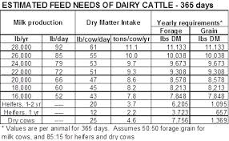
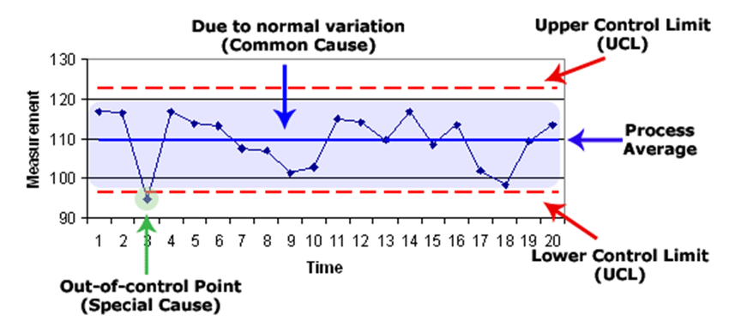
Sharing findings
Examples of vocational settings involving tables, graphs diagrams.
What type of communication occurs?
- health care
- industry (spc)
- agriculture
- food (preparation)

Slide 6
Communicative practices with (vocational) graph & tables
Types of language involved
- language of vocational situation -> specific 'jargon'
- mathematical language (related to graphs, tables)
- everyday language
with.... | type .... | aim....
colleagues
boss
assistants/ apprentices
customers
.......

Slide 7
Program
Starter
Role of communication in vocational situations (+graphs)
Examples from the module: rich communicative practices
Sharing outcomes of classroom experiment (homework)
Analysing student work and reflection
Evaluation

Slide 8
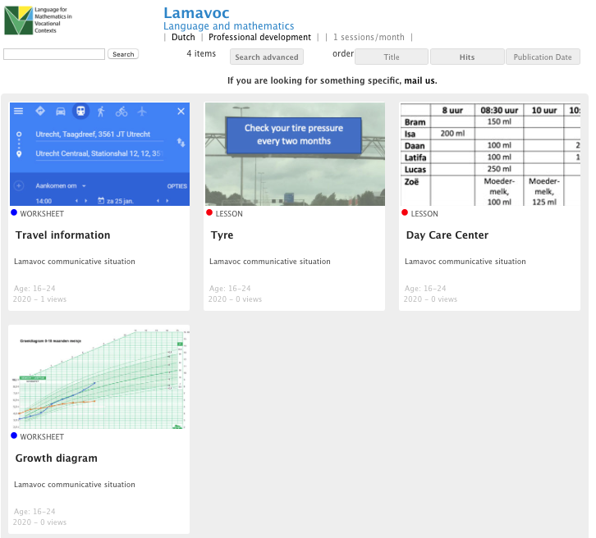
Three communicative situations on graphs/tables
fi.uu.nl/publicaties/subsets/lamavoc_en
Notes:
fi.uu.nl/publicaties/subsets/lamavoc_en
Have participants read the background information on the communicative tasks (part 1 of the module) and explore the three tasks and the teacher guides (from the module or online)

Slide 9
SITUATIONS
A | Tyre pressure The context of tire pressure is introduced. Students study a large table with data on tire pressure. Next they do an activity in which they act as junior assistants working at a gas station explaining to customers how they can find the correct tire pressure for their car form the table at the gas station. The product is a script which can be used for a video-clip, a podcast or an acted out role-play.
B | Growth diagrams A growth chart is used to follow a child's growth over time, for health purposes. Another presentation mode is the table, where you see the weight (and length) of a child every month. The weights of three babies have been recorded every month from their day of birth on. Look at the data in the table. What can you tell about these babies? The students are asked to fulfill the vocational task to advice parents about the growth of their babies. With audio recording of the actual conversations about the growth charts both students and teacher get feedback what the actual role is of the 'language of mathematics'.
C | Travel information In using public transport you need knowledge and skills about online information in order to make a plan for your travel. Information is shown in tables most of the times. In this situation you are asked to help elderly people, both interactively and by writing a manual (for your internship at a local government; the manual can also be a short video). You work in pairs or with three students.

Slide 10
Three communicative core tasks
General structure of the tasks
  Exploring the context and its language
  Exploring the mathematical concepts and the mathematical language
  Preparing the communication (e.g. writing a script)
  Communicative practice (role-play, podcast, blog/vlog, .....)
  Reflecting
Notes:
.

Slide 11
Program
Starter
Role of communication in vocational situations (+graphs)
Examples from the module: rich communicative practices
Sharing outcomes of classroom experiment (homework)
Analysing student work and reflection
Evaluation

Slide 12
Sharing experiences
Form small groups of teachers who tried the same communication assignments in class
Share the experiences
  What went well (for your students)?
  What were problems? Where these related to language? To mathematics?
Share among small groups
  What was similar?
  What was different?

Slide 13
Program
Starter
Role of communication in vocational situations (+graphs)
Examples from the module: rich communicative practices
Sharing outcomes of classroom experiment (homework)
Analysing student work and reflection
Evaluation

Slide 14
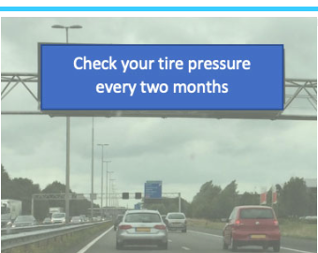
Tire pressure - an example
The context of tire pressure is introduced.
Students study a large table with data on tire pressure.
Next they do an activity in which they act as junior assistants working at a gas station explaining to customers how they can find the correct tire pressure for their car form the table at the gas station.
The product is a script which can be used for a video-clip, a podcast or an acted out role-play.

Slide 15
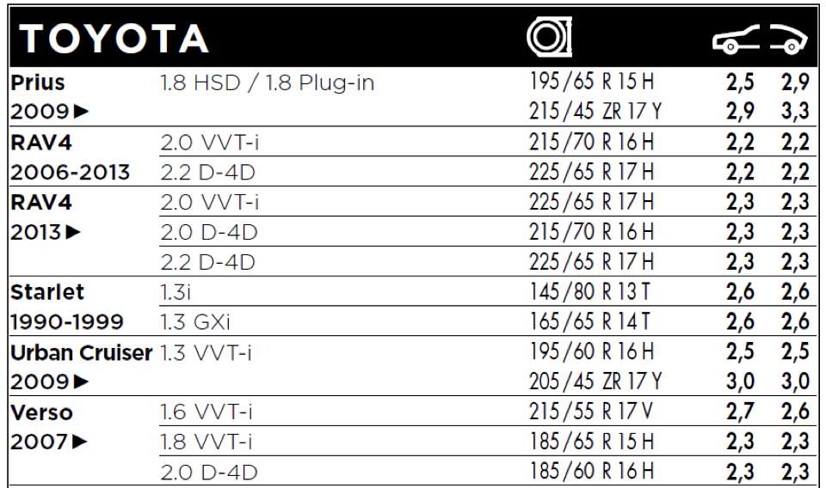
Table
Try to find your car and pressure in the table
Notes:
Source

Slide 16
Analyse student work
Use worksheet 1
On this worksheet you find three examples of student scripts and calculations for the Tire pressure task.
Evaluate each example for the requirements of the task.
  Take into account all aspects: the vocational context, the communicative practice and the mathematics and its languages.
  You may also use the following guiding questions:
      What does each group of student appear to understand (of the context, math and the communicative task) ? How can you tell?
      List errors and difficulties that are revealed by the students' scripts and calculations.
      What feedback would you give each group?
      In what way would you support the students working on this task?
Notes:
These are translated materials form Dutch students.
More Dutch Resources exist but have not yet been translated: Two audio-sources from duo’s of students Written scripts (12, two classes)

Slide 17
Sharing findings
Use these questions to guide the discussion
What does each group of student appear to understand (of the context, math and the communicative task) ? How can you tell?
List errors and difficulties that are revealed by the students' scripts and calculations.
What feedback would you give each group?
In what would would you support the students working on this type of communicative practices?

Slide 18
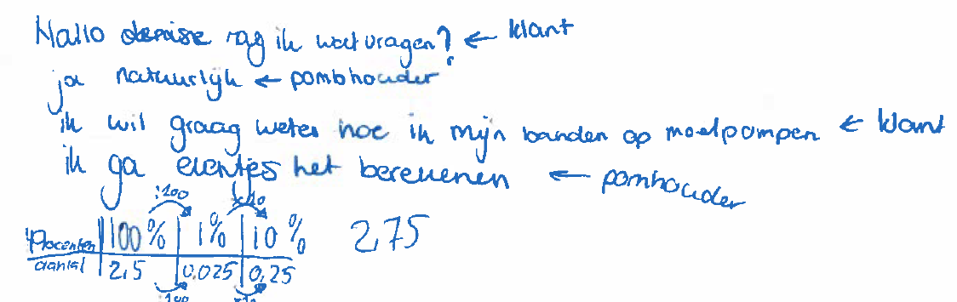
Group 1
Hello, can I ask you something? <-customer
Yes of course <- gas station assistant
I want to know how to pump my tyres for extra pressure <-customer
I will calculate it for you <-gas station assistant)

Slide 19
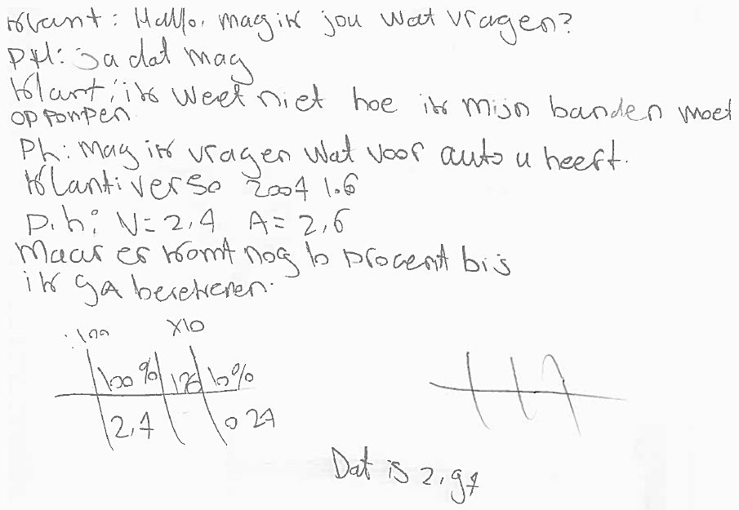
Group 2
Customer: hello, can I ask you something?
PH: Yes, you can
Cust: I don’t know how to pump my tyres
Ph: can I ask you what kind of car you have?
Cust: Verso 2007 1.6
Ph: V= 2,4 A =2,6 [V is front axle. A is back axle]
But an additional 10% is needed. I will calculate this [see table and answer 2.97]

Slide 20
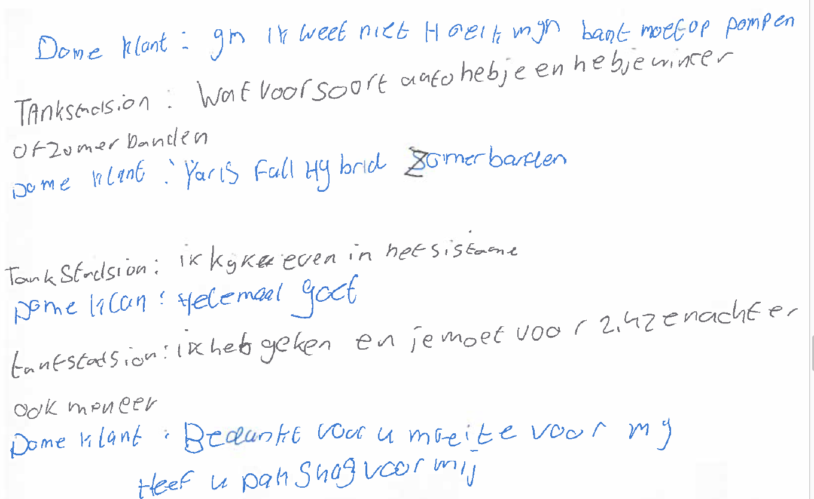
Group 3
Customer: I don't know how to pump up my tyres
Pump assistant: What kind of car do you have and does it have summer or winter tyres?
C: Yaris full hybrid, summer tyres
PA: I will take a look in the system
C: Very well
PA: I have looked and you need 2.42 front and also back, sir
C: Thanks for your effort. Do have a pack of chewing gum for me?
Notes:
Customer: hm, I don't know how to pump up my tyres
Pump assistent: What kind of car do you have and does it have summer or winter tyres?
C: Yaris full hybrid, summer tyres
PA: I will take a look in the system
C; very well
PA: I have looked and you need 2.42 front en also back, sir
C: Thanks for your effort. Do have a pack of chewing gum for me?

Slide 21
Evaluation
Discuss the value of this type of tasks for .....
  mathematical understanding
  vocational competencies
  language proficiency
Notes:
You may do this in the form of a debate. Divide the group in two: one subgroup is in favor of these type of taks and sees their (added) value, while the other group does not see this.

Slide 22
Program
Starter
Role of communication in vocational situations (+graphs)
Examples from the module: rich communicative practices
Sharing outcomes of classroom experiment (homework)
Analysing student work and reflection
Evaluation

Slide 23
Evaluation of the pd course
What have you learned about
Language sensitive math teaching on the topic of graphs and tables?
Communicative practices in vocational settings using graphs and tables
The relation between developing conceptual understanding in mathematics and language

Slide 24
What is relevant in language-responsive math classrooms?
(Prediger & Wessel 2011, 2013; Prediger, Clarkson, & Bose 2015)
Different registers (= languages and representations)
Symbolic-algebraic representation
Symbolic-numerical representation
Verbal technical register in first language
Verbal technical register in second language
Changing
and
relating
registers
and repre-
sentations
Verbal school academic
register in first language
Verbal school academic register in second language
Verbal everyday
register in first language
Verbal everyday register in second language
Graphical representation
Concrete representation
(artefact, actions etc.)
Notes:
Recapitulate the connected relevance for language in mathemtics learning

Slide 25
Jobs for teachers in language-responsive math classrooms
Five jobs
Noticing
language
Demanding language
Supporting
language
Developing language
Identifying mathematically relevant language demands
Typical
misunderstandings
Language-responsive means reducing all language demands
All students are trained to use formal terms like numerator and denominator
Important
principles
Rich discourse practices instead of isolated words
Focus on conceptual understanding and explaining meaning
Offensive rather than defensive approach (pushing language)
Notes:
Ak teachers at what jobs they see themselves as more 'skilled' after the PD course and what their future plans are for language sensitive math teaching

